Slide 1


Java in Education
JUG Presenter Name here
For Junior Developers and Students
Prepared by Ken Fogel & the JCP Executive Committee (EC) Java in Education Working Group
Notes:
If you plan to do the demonstrations you will need a computer with Java 14 or greater. The demonstrations require JShell and the ability to run java from the command line
Download the files from the github repository https://github.com/omniprof/JCP_EC_Education_WG_Presentation.
Place the java, python and txt file into a folder and have a console/terminal opened to that folder.
Open the JShellDemoCode.txt in an editor as you will need to copy the contents of the file into the JShell Edit Pad.
Open JavaCalculations03.java in an editor as you will need the java command line statement at the end of the file.
Open a JShell console.
You are ready to begin.
NOTE For JUG leaders/Java Community Leaders: There are ore resources and tips for community members working with students and universities on the wiki https://community.oracle.com/community/groundbreakers/java/jcp/java-in-education/overview

Slide 2
Java Language Enhancements
This presentation looks at enhancements to the Java language
These enhancements help dispel some of the myths surrounding Java.
It is about why Java should be the language taught at all levels in schools today.
There is even a comparison of a program in Java and Python.
Notes:
Over the last few years Java has gained the unfounded reputation of being difficult to code, old fashioned in its structure, and significantly verbose as compared to other languages.
This means that new users and users of other languages shy away from Java because they believe they will have to write a lot more code to get things done in Java.
In this presentation we will look at enhancements to Java that continue to make Java the best language for education for new programmers.

Slide 3
JShell - Read-Evaluate-Print Loop (REPL) JDK 9
A tool for simplifying instruction.
Execution as you enter code and press return.
Immediate response line by line.
You can also write entire methods first and then execute them.
Ideal in teaching Java one line at a time.
Notes:
JShell is all about immediate feedback.
There is no need to start-up a complex IDE such as IntelliJ, Eclipse or NetBeans.
It is not even necessary to have a text editor.
It can be used to enter and execute lines one at a time.
Using its own built in JShell Edit Pad you can write full methods and execute them right away.
Bring the JShell console/terminal window to the foreground
Enter “/edit” to open the JShell Edit Pad.
Show the audience the contents of the JShellCodeDemo.txt file pointing out it is just a single method without any class decorations.
Copy the text and paste it into the JShell Edit Pad and click on the buttons ‘Accept’ and then ‘Exit’.
Now type ‘loan()’ at the prompt in JShell. You can now enter an amount of money to borrow, the annual interest rate and the number of months you will take to repay the loan.

Slide 4
JEP 330 - Launch Single-File Source-Code Programs JDK 11
Addresses the overhead of running code
  Traditional Style
    Two-step to execution
      javac
      java -jar
  Single-File Source-Code Style
    One-step to execution
      java
        If the file has a public class with a main it compiles and executes
        Works with preview features as well as established features
        Single file may contain multiple classes
This may be the second* most significant new capability for writing Java for those wishing to learn the language
No need to master an IDE to learn Java.
The first will be shown on slide 18.
Notes:
When learning a new language you want the focus on the language.
Using an IDE introduces a tool that must also be learned. This may not be a problem for an experienced developer looking to learn Java but a student at any level will likely find the tool distracting.
Python launches programs with just a single command line. Now Java does too.
The single file may contain just one class with its main method or multiple classes.
While the conventions for writing Java tells us to use multiple class files, that was never necessary.
Single-File Launch requires just a text editor, notepad or vim, and code can be compiled and executed in a single command line. No IDE to muddy the waters.
In the Linux/Mac environment there is the Shebang syntax that makes running a single-file program as easy as running a shell script.
Do a demonstration of a single-file program.
Bring up the editor that has JavaCalculations03.java. This is an OOP version of a loan calculation. It uses the preview feature ‘record’. Copy the java statement at the end of the file.
Bring up the console/terminal you prepared that is in the folder that the java files are in.
Paste the java command line into the console/terminal and the program will begin and ask you for the loan input data.
The other two java files will also run at the command line.

Slide 5
var – reduction of redundancy reduction JDK 10
No more:
MyClass m = new MyClass();
It now becomes:
var m = new MyClass();
Encourages only creating objects with initialization
Will reduce the occurrence of the dreaded NullPointerException
Notes:
Java is a typed language.
Every variable musts be declared with a type.
Primitives just need the type shown once such as ‘int x;’
References have required that the type is shown twice.
The new var keyword eliminates this repetition.
Another complaint about verbosity or excess coding is removed.
One of the most common reasons for a local NullPointerException is neglecting to instantiate a reference. With var it must be instantiated.

Slide 6
text blocks (15)
Finally, what you enter into your source code is what you get
Especially useful for Strings that contain HTML, XML and JSON
Who doesn’t like writing three quotation marks in a row
"""
"""
Notes:
Does anyone really like concatenating long strings so that they don’t continue past the edge of the string?
What about formatted strings such as in XML or HTML? Not only do you have to concatenate but you also have to insert spaces to maintain the format. Its doubtful anyone bothers to do so.
The next two examples show an HTML page as a single string. It should be obvious which one makes more sense.

Slide 7
Old School Concatenation
String htmlStr = "<html><head><link rel='stylesheet' "
+ "href='styles/main.css' "
+ "type='text/css'/><title>The Learning Servlet</title></head>"
+ "<body><h1>GET method</h1>"
+ "<form id='form:index' action='index.html'>"
+ "<br/><input type='submit' value='Return to Home page'/></form>"
+ "</body></html>";
Notes:
The bad old days of quotation marks, pluses and strings.

Slide 8
New School Text Block JDK 15
String htmlStr = """
<html>
<head>
<link rel='stylesheet'href='styles/main.css' type='text/css’/>
<title>The Learning Servlet</title>
</head>
<body>
<h1>GET method</h1>
<form id='form:index' action = 'index.html'>
<br/>
<input type= 'submit' value='Return to Home page' />
</form>
</body>
</html>""";
Notes:
The 21st century approach to long strings.
The left most string defines the left margin and that many spaces are trimmed from every line.
Spaces to the right are left as is.

Slide 9
But wait, there is more . . . String formatted JDK 15
out.println("""
<html>
<head>
<title>Just Servlet Output</title>
<link rel='stylesheet' href='styles/main.css' type= 'text/css'/>
</head>
<body>
<h1>Thanks for joining our email list</h1>
<p>Here is the information that you entered:</p>
<label>Email:</label>
<span>%s</span>
</body>
</html>""".formatted(user.getEmailAddress()));
Notes:
Here we are using the String formatted method to support inserting place holders for variables into a String similar to printf.

Slide 10
switch – an expression & without a break JDK 14
A switch that can be explained sensibly
Reduction in duplication of code when used to set a value
Switch expressions or switch rules
The end of break, all cases terminate!
Notes:
The Java switch is really the original C switch.
While much has changed the switch has not.
Now we have three different formats for a switch. The original, the expression and the rule.
Verbosity is again reduced with the elimination of break in the expression and rule styles.
Its even more dramatic when reducing the amount of code you need to write as the next slide will show.

Slide 11
Which would you prefer to learn or teach?
double value = 0;
switch (point) {
case NORTH:
value = 12.12;
break;
case SOUTH:
value = 14.14;
break;
case EAST:
value = 16.16;
break;
case WEST:
value = 18.18;
break;
}
double value = switch (point) {
case NORTH -> 12.12;
case SOUTH -> 14.14;
case EAST -> 16.16;
case WEST -> 18.18;
default -> 0.0;
};
Notes:
This is the expression format switch.
The traditional switch on the left is 15 lines.
The new expression switch is 7 lines.
Not needing to explain why every case needs a break will make Java more of a joy to teach.

Slide 12
And then there is the pattern matching switch.
Still in preview in JDK 20.
Object x = "4";
String designation = switch (x) {
// case Integer i when i > 4 && i < 12 -> "child";
case Integer i when i < 12 -> "child";
case Integer i when i < 18 -> "teenager";
case Integer i when i < 25 -> "young adult";
case Integer i when i < 65 -> "adult";
case Integer i when i >= 65 -> "senior";
default -> "Not an Integer";
};
System.out.printf("Designation is %s%n", designation);
Notes:
In the pattern matching switch you may use an object as a parameter to the switch.
Each case can test if the object is either a specific object type or its superclass.
It also introduces multiple tests in a case.

Slide 13
records – boilerplate reduction with immutable flavouring and a dash of compact constructor
JDK 16
Data objects are known for boilerplate code:
Initializing constructors, setters, getters, equals, hashCode, and toString
To the rescue is the immutable record
More than just a simplification of a bean
It’s the path to objects defaulting to immutability
And then there is the compact constructor
Validating initial values without a separate constructor
Notes:
The JavaBean style class is the go to class design for holding data.
Numerous frameworks depend on classes with setters, getters, hashCode, equals and toString.
The modern programming model is moving away from the mutable to the immutable bean, initialized thru the constructor and only have getters plus the others.
The new record class type addresses amount of code you need to write and encourages immutability.
Immutable data objects can take center stage in an application.

Slide 14
No setters, just simple getters.
Implied equals, hashCode and toString.
And what a lovely compact constructor for validation.
public record Person(String firstName,
String lastName,
int age,
String postion,
LocalDate birthday) {
public Person{
if (age < 18) {
throw new IllegalArgumentException("Too young");
}
}
}
Notes:
Rather than instance variables declared after the class declaration they are now listed in the class signature.
These instance variables are private naturally.
Notice what is missing.
There are no setters so that the object created this was is immutable.
There is no getter but the value of any instance value can be read just using the name of the variable.
There is a hashCode, equals, and toString there to be used.
The new compact constructor allows for validation if required.

Slide 15
Virtuous Virtual Threads preview in JDK 20, final version in JDK 21.
public class VirtualThread
extends Thread { . . }
public void perform() {
for (int i = 0; i < 5; ++i) {
Thread.ofVirtual()
.name("Thread # " + i)
.start(new VirtualThread ());
}

Slide 16
Paving the on-ramp
In September 2022 Java Language Architect Brian Goetz released a paper called Paving the on-ramp
(https://openjdk.org/projects/amber/design-notes/on-ramp)
public class HelloWorld {
public static void main(String[] args) {
System.out.println("Hello World");
}
void main() {
println("Hello World");
}
will become
Java can be learned without all the OOP decorations
Methods can be written
New learners can focus on syntax initially

Slide 17

Machine Learning with Java - JSR 381 Visual Recognition
Ken Fogel
Java Champion
JCP EC Member
Research Scholar in Residence – Dawson College
Packt & Apress Author
Retired Dawson College CS Instructor

Slide 18

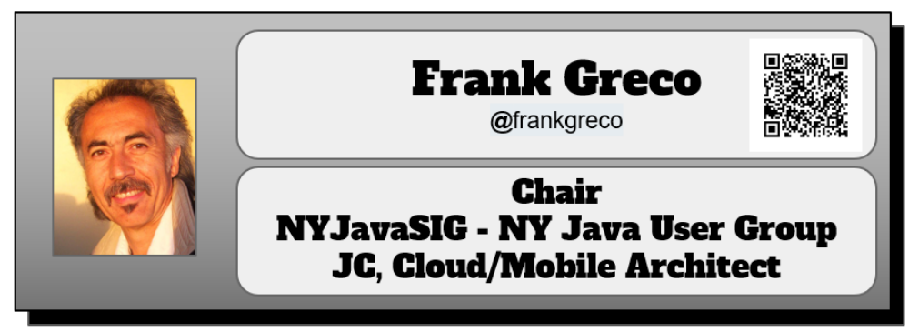
First, some credit for the source material in this presentation
This presentation is based on the work of the following two developers/researchers, with their permission, that are part of the team who developed JSR 381

Slide 19
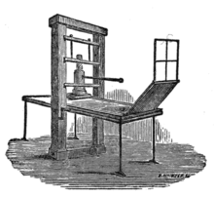
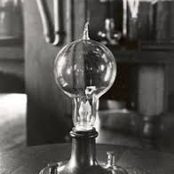
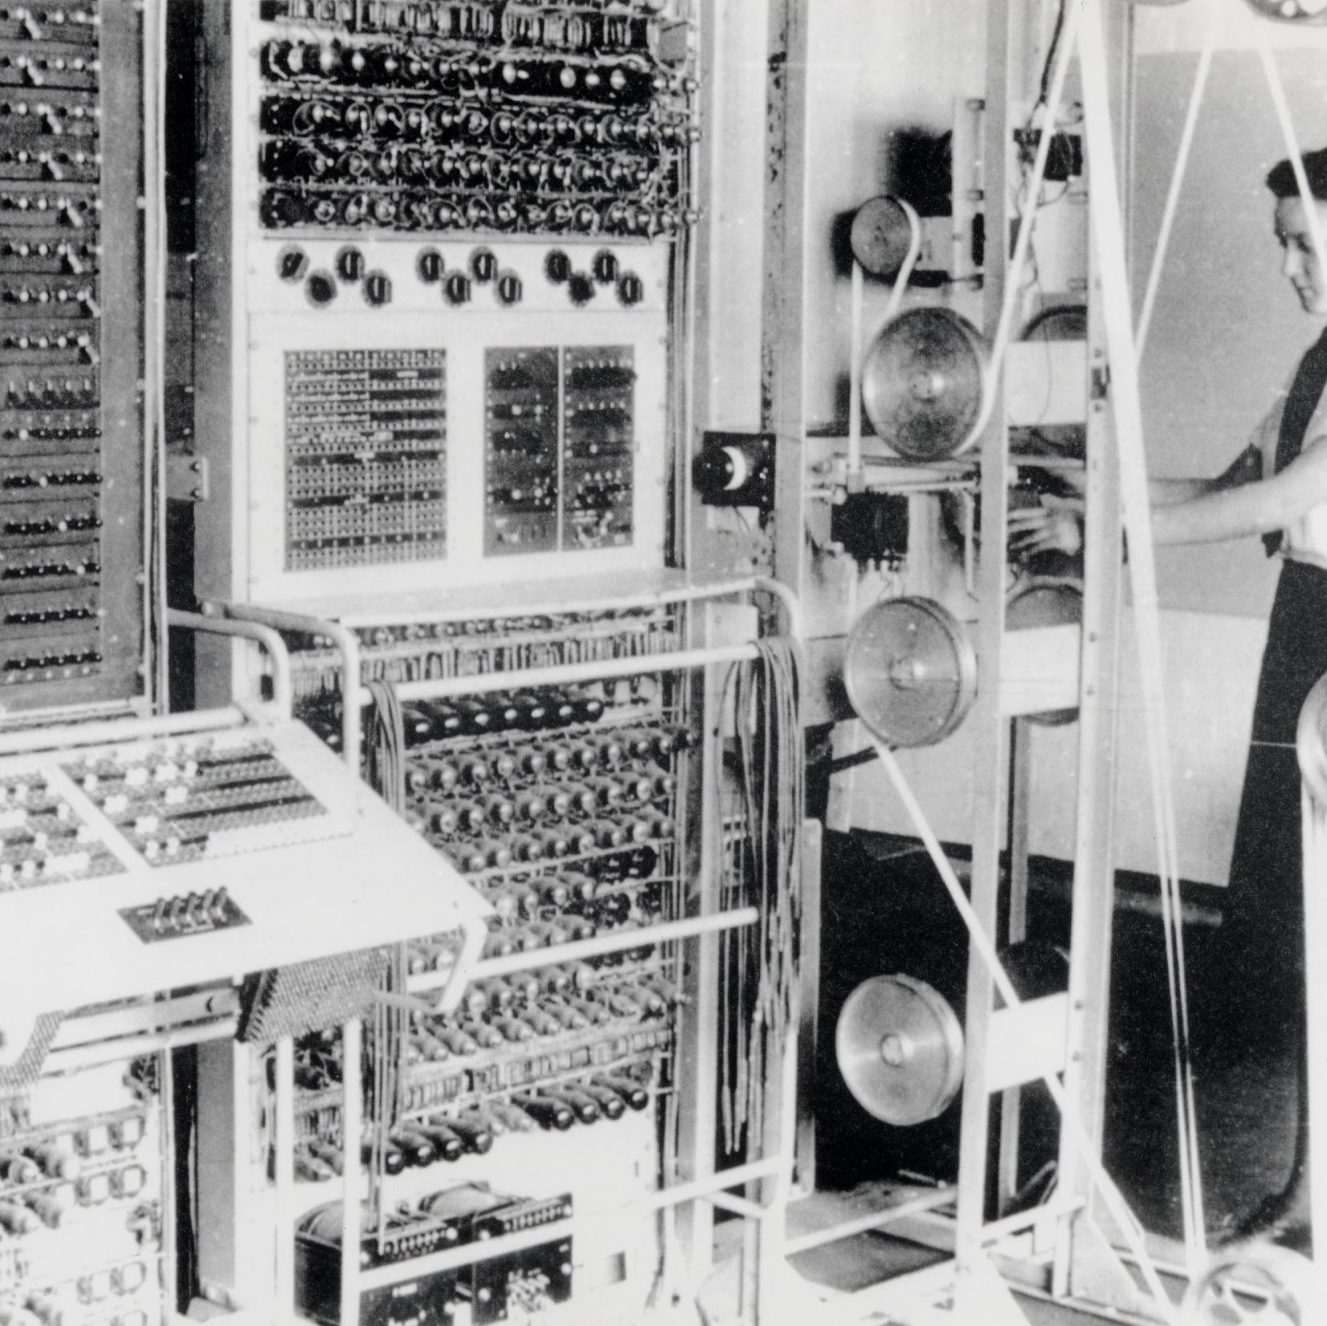
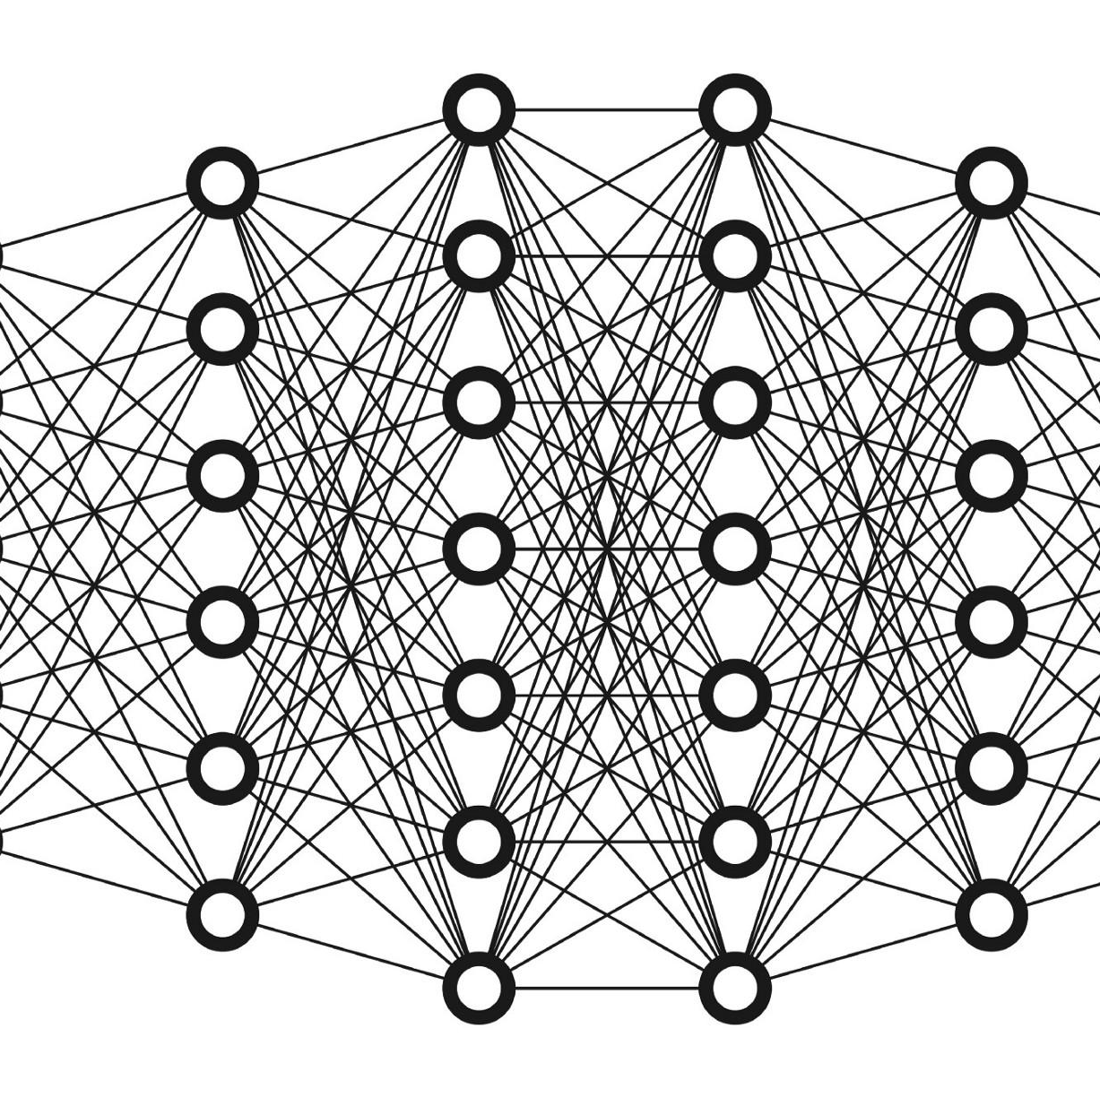
Machine Learning
Huge Impact on Everything...
Notes:
ML is a major innovation with many implications for humanity.

Slide 20
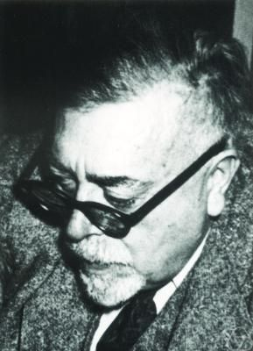
“One of the most interesting aspects of the world is that it can be considered to be made up of patterns”
Norbert Wiener - 1894-1964 - MIT
Cybernetics (1948) - early steps to modern AI
This was AI before it was called “AI”

Slide 21

The Core of Machine Learning
Recognizing PATTERNS in data and
Making PREDICTIONS against that data.
Notes:
Then: ALGORITHMS + data = solution
Now: algorithms + DATA = solution
Lehman - monitoring Fixed Income subsystems for KPIs. Managers were not overly interested in up/down, cpu load, memory usage, http requests, etc… they wanted to know any issues were not addressed (notifications to humans were essentially useless), if they made money and most importantly why did they make money.

Slide 22

You can write your Machine Learning app in any language you want, as long as it’s Python.
Notes:
:))))

Slide 23

You can write your Machine Learning app in any language you want, as long as it’s Python.
Hey!!
Notes:
:))))

Slide 24

HEY!
HEY!
HEY!
HEY!
HEY!
HEY!
HEY!
HEY!
HEY!
HEY!
HEY!
HEY!
HEY!
HEY!
HEY!
HEY!
HEY!
HEY!
HEY!
HEY!
HEY!
HEY!
HEY!
HEY!
HEY!
HEY!
HEY!
HEY!
HEY!
HEY!
HEY!
HEY!
HEY!
HEY!
HEY!
HEY!
HEY!
HEY!
HEY!
HEY!
HEY!
HEY!
HEY!
HEY!
HEY!
What the Hey!
~12M Java Devs
Notes:
:))))

Slide 25
JSR 381 - Visual Recognition API
Java-friendly standard API for computer vision tasks using ML
Provides a generic ML API
Designed for Java app devs
Multiple implementations
High level abstractions
Readable and easy to use

Slide 26
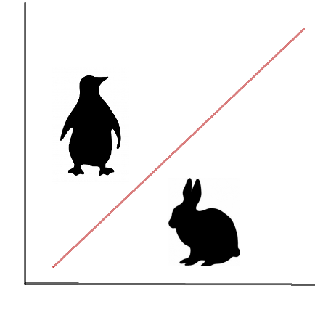
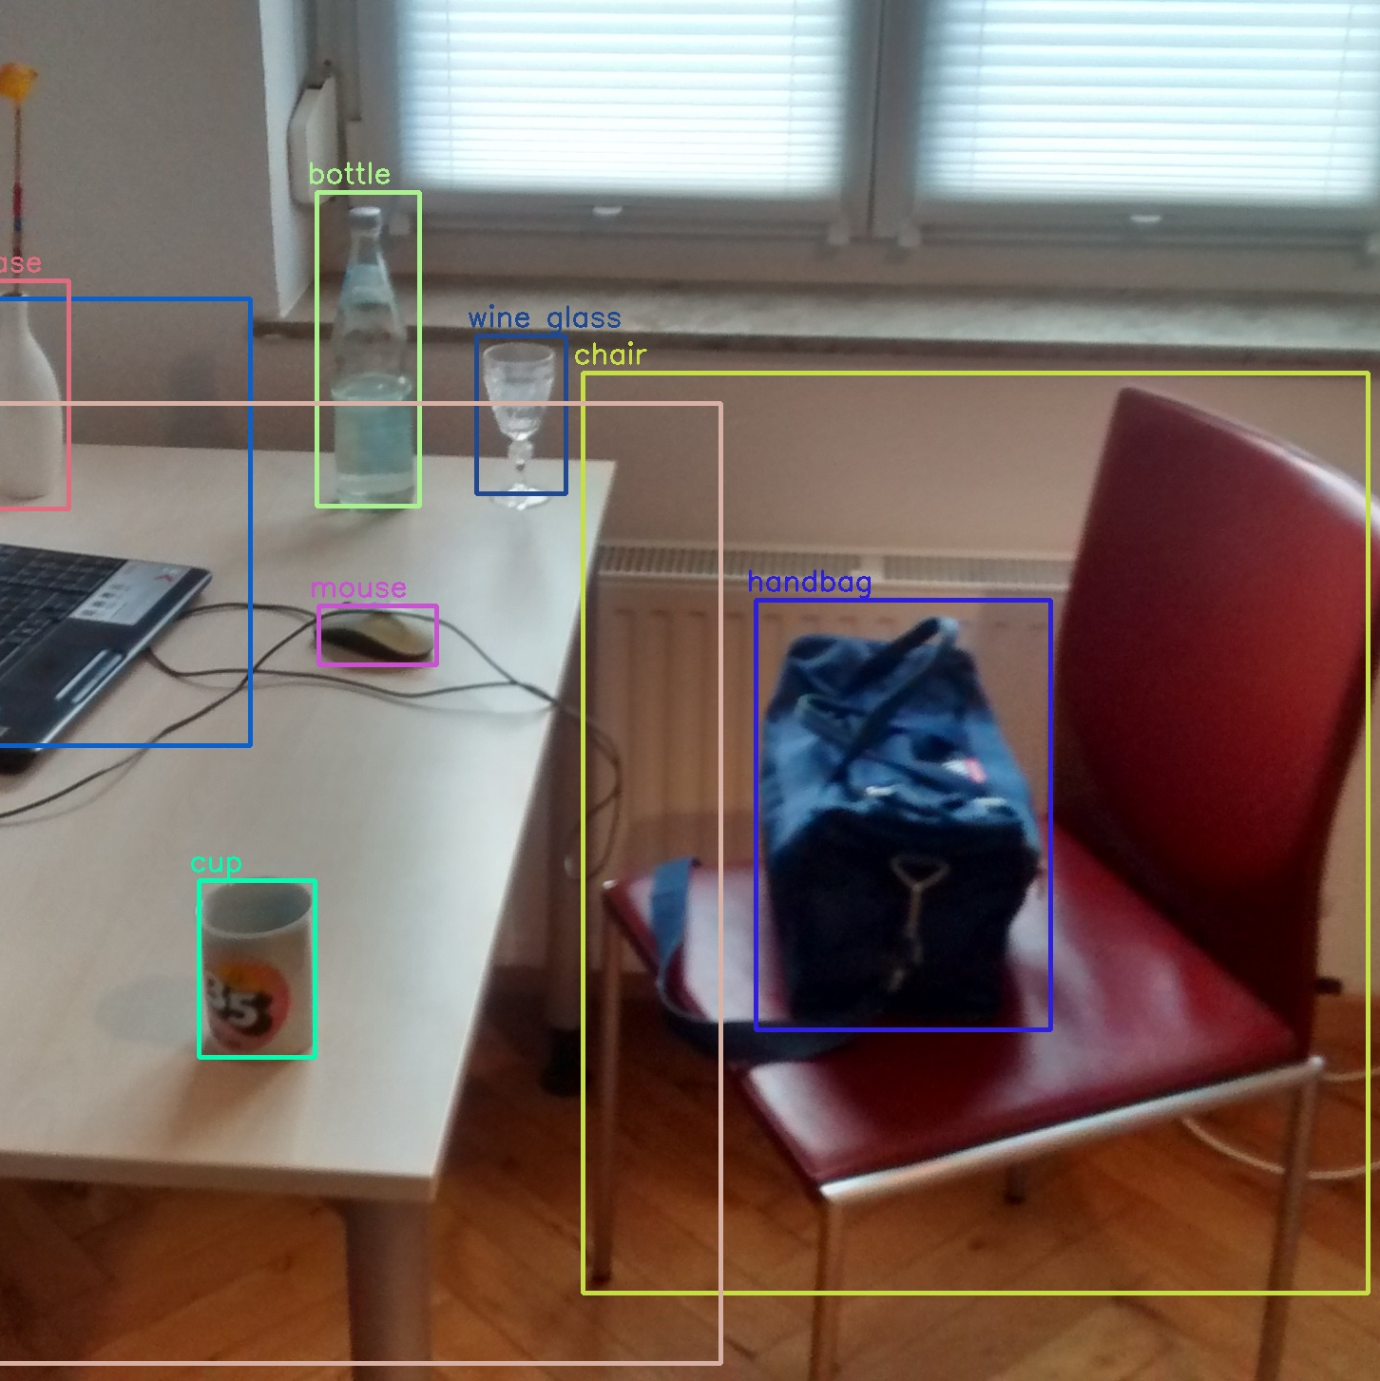
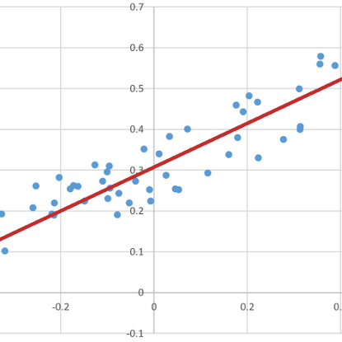
What Can you Do with It?
Object Detection
classification + regression(position)
Classify images and data/objects
Classification task / differentiate between categories
Estimate value
regression task
Notes:
Assign items to predefined categories
(Classification task, incl. Image classification=classification with image data as input)
Model relationship between some values in order to be able to predict them
Regression task
In order to understand the context of the design....
Show to developer who dont knows about ML, how to think about the machine learning and use it
ML is a type of algorithm which can automatically tune its internal parameters in order to be able to perform some task with degree of accuracy.
It performs this self configuration using a given set of examples (data set)

Slide 27
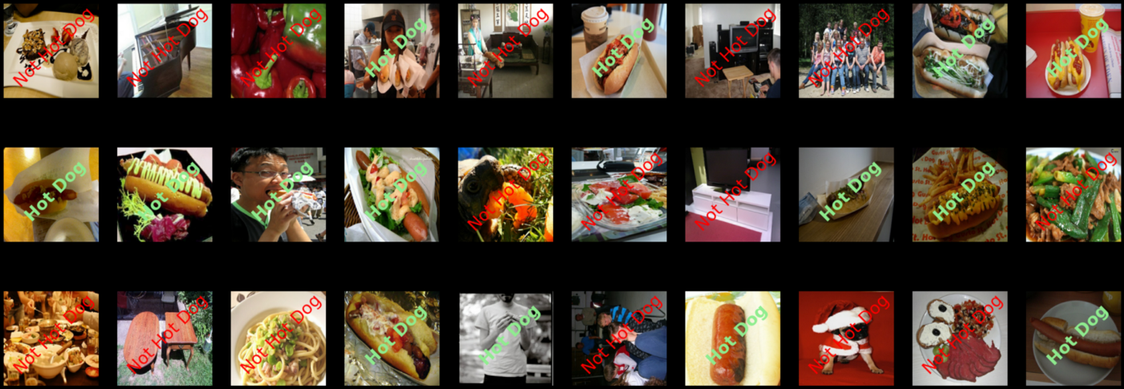
Hot Dog or Not Hot Dog
Hot Dog or Not Hot Dog
Scene from TV show Silicon Valley https://www.youtube.com/watch?v=vIci3C4JkL0

Slide 28

Demo Time!

Slide 29
The future of AI/ML in Java
Upcoming enhancements to the language will be significant for ML
JEP 417: Vector API - https://openjdk.org/jeps/438
Project Valhalla – Value Objects
Project Panama – Connecting Java to foreign (non-Java) libraries such as those written in C.
  This will allow Java to use an AI/ML written in C/C++

Slide 30

Reference Implementation
Reference implementation of VisRec API is based on
the Deep Netts Community Edition which is a Java based
deep learning library provided by www.deepnetts.com
More info: https://www.deepnetts.com/blog/deep-netts-community-edition
DeepNetts has released a community edition of their deep learning engine, and contributed their experience to this JSR
as a part of their open-source strategy

Slide 31

Additional
Implementation
There is a second ML library that is compatible with JSR 381
The AWS Deep Java Library or DJL
Open-Source library from Amazon
To learn more visit https://github.com/deepjavalibrary/djl
JSR 381 DJL implementation https://github.com/JavaVisRec/visrec-djl

Slide 32
JSR381 Information
JCP.org https://jcp.org/en/jsr/detail?id=381
JSR project on GitHub github.com/JavaVisRec
API github.com/JavaVisRec/visrec-api
RI github.com/JavaVisRec/visrec-ri
Examples github.com/JavaVisRec/jsr381-examples
Mailing list visrec@groups.io
Notes:
Mention nd-standardization

Slide 33
Here is a list of image datasets:
http://vision.stanford.edu/aditya86/ImageNetDogs/
https://stanfordaimi.azurewebsites.net/
https://imerit.net/blog/22-free-image-datasets-for-computer-vision-all-pbm/
https://datagen.tech/guides/image-datasets/image-datasets/
https://hackernoon.com/top-20-image-datasets-for-machine-learning-and-computer-vision-rq3w3zxo
https://storage.googleapis.com/openimages/web/index.html
https://www.analyticsvidhya.com/blog/2018/03/comprehensive-collection-deep-learning-datasets/

